Slide 1
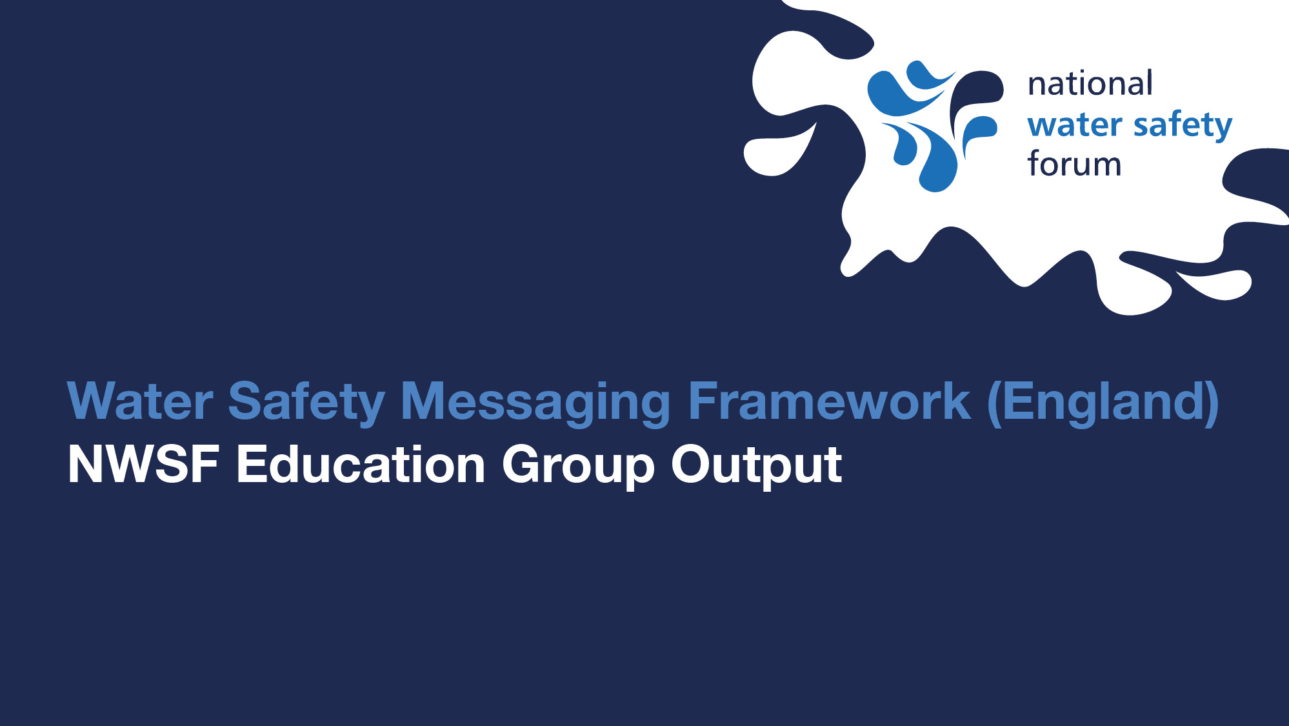

Slide 2
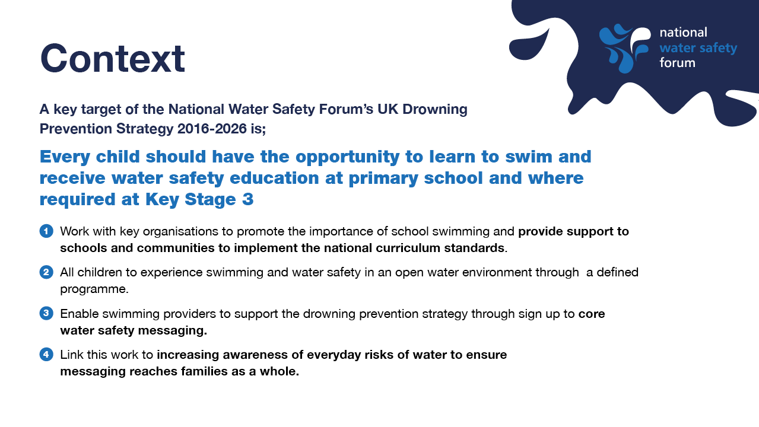
Notes:
To deliver on this target, partners continue to work to drive a generational change in water safety education, while promoting enjoyment in, on and around the water. This work focuses on delivering the following key objectives;

Slide 3
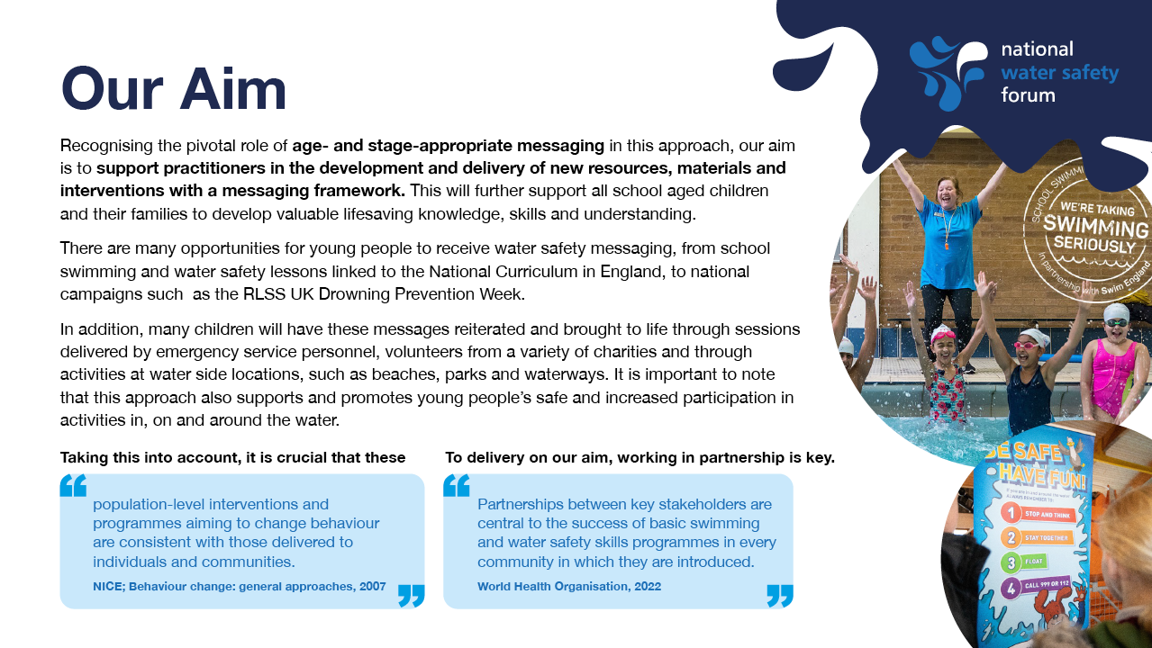
Notes:
Recognising the pivotal role of age- and stage-appropriate messaging in this approach, our aim is to support practitioners in the development and delivery of new resources, materials and interventions with a messaging framework. This will further support all school aged children and their families to develop valuable lifesaving knowledge, skills and understanding.
There are many opportunities for young people to receive water safety messaging, from school swimming and water safety lessons linked to the National Curriculum in England, to national campaigns such as the RLSS UK Drowning Prevention Week.
In addition, many children will have these messages reiterated and brought to life through sessions delivered by emergency service personnel, volunteers from a variety of charities and through activities at water side locations, such as beaches, parks and waterways. It is important to note that this approach also supports and promotes young people's safe and increased participation in activities in, on and around the water.
Taking this into account, it is crucial that these “population-level interventions and programmes aiming to change behaviour are consistent with those delivered to individuals and communities.” NICE; Behaviour change: general approaches, 2007.
To delivery on our aim, working in partnership is key. “Partnerships between key stakeholders are central to the success of basic swimming and water safety skills programmes in every community in which they are introduced” World Health Organisation (2022)
Preventing drowning: practical guidance for the provision of day-care, basic swimming and water safety skills, and safe rescue and resuscitation training. Geneva: World Health Organization; (2022)

Slide 4
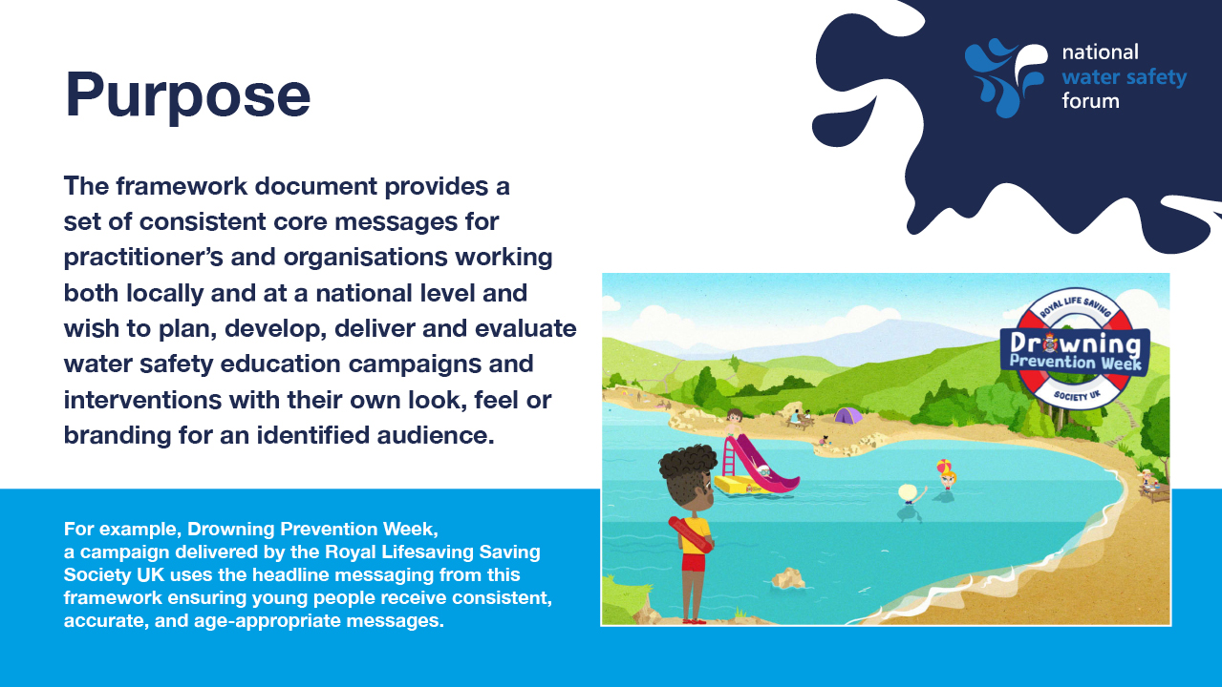
Notes:
Purpose - The framework document provides a set of consistent core messages for practitioner’s and organisations that wish to plan, develop, deliver and evaluate water safety education campaigns and interventions with their own look, feel or branding for an identified audience.

Slide 5
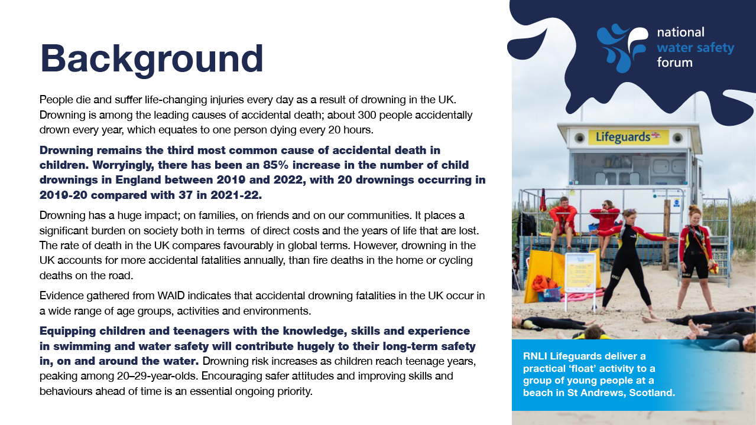
Notes:
NCMD (2023) Report: Deaths of children and young people due to traumatic incidents.

Slide 6
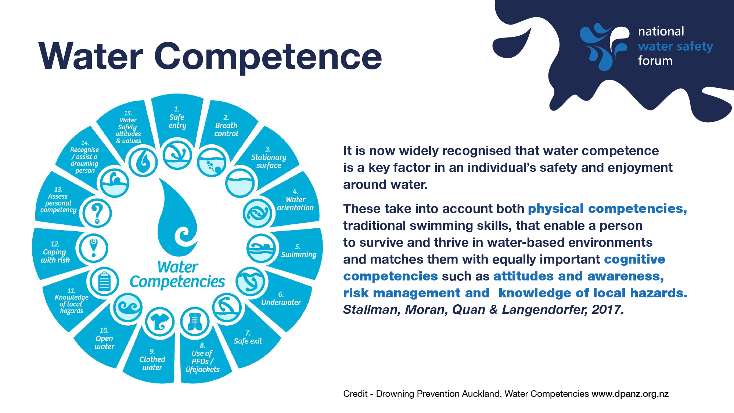
Notes:
It is now widely recognised that water competence is a key factor in an individual's safety and enjoyment around water.
In 2007 the International Life Saving Federation (ILSF), released a position statement regarding ‘Swimming and Water Safety Education’ which highlighted the importance of the inclusion of water safety knowledge.
Subsequent international research (Stallman, Moran, Quan, & Langendorfer, 2017) provided evidence of 15 water competencies. These take in to account both physical competencies (traditional swimming skills) that enable a person to survive and thrive in water based environments and matches them with equally important cognitive competencies such as attitudes and awareness, risk management and knowledge of local hazards.
The large format version of this document available in the index draws a direct link between the physical and cognitive competencies that together make a person water competent
International Life Saving Federation (ILSF), (2007). Swimming and Water Safety Education:
Stallman, Robert Keig; Moran, Kevin Dr; Quan, Linda; and Langendorfer, Stephen (2017) "From Swimming Skill to Water Competence: Towards a More Inclusive Drowning Prevention Future," International Journal of Aquatic Research and Education: Vol. 10

Slide 7
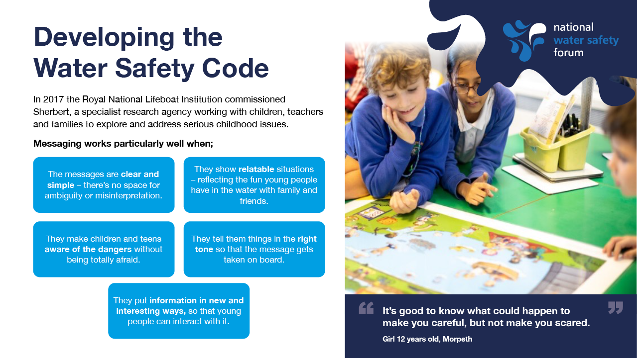
Notes:
In 2017 the Royal National Lifeboat Institution commissioned Sherbert, a specialist research agency working with children, teachers and families to explore and address serious childhood issues.
Following a series of focus groups with teachers, parents and young people, together with research into current campaigns and curricula developed for young people, we learnt that messaging works particularly well when;
The messages are clear and simple – there’s no space for ambiguity or misinterpretation
They show relatable situations – reflecting the fun young people have in the water with family and friends
They make children and teens aware of the dangers without being totally afraid
They tell them things in the right tone so that the message gets taken on board
They put information in new and interesting ways, so that young people can interact with it
We also learnt that some of the messages were struggling to cut through and resonate with young people.
More specifically:
When the words and sentences don’t make sense to them so they are unable to relate to the main message and it feels out of context from what they know and understand. This usually occurs through ‘clever’ phrasing or using technical language. If messages aren’t straight forward or require too much effort to interpret them they are likely to be missed or critiqued so the meaning can be lost.
When the tone for the message jars with the subject matter and messaging.
When the call to action isn’t clear and leaves them feel unsure about what to do.
Sherbert Research - https://www.sherbertresearch.com/
Fresh, Fun & Kid-focused
In 2003, Nicki set-up Sherbert to bring a new kind of agency to the world of research and a brand that reflects the audience we love to explore and spend time with. And an equally passionate team joined along the way! Young people are at the heart of everything we do. We champion their views and opinions and are committed to making the world a safer, more exciting place for them to live. They love to talk and we definitely love to listen!
‘Childhood’ experts
Pre-schoolers, kids, tweens, teens, parents, teachers and families now all form part of our research world and we embrace the variety of playing on the floor with 4-year-olds one day, hanging out with teenagers in the bedroom the next, just as much as exploring serious childhood issues with parents and professionals.
A trusted pair of hands
We conduct our work with the highest standard of care and professionalism and our research paints a picture of children’s lives that brings clients closer to this amazing audience and their needs and motivations. Our industry experience and brilliant client portfolio demonstrates our commitment to delivering, engaging and inspiring outputs with confidence.

Slide 8
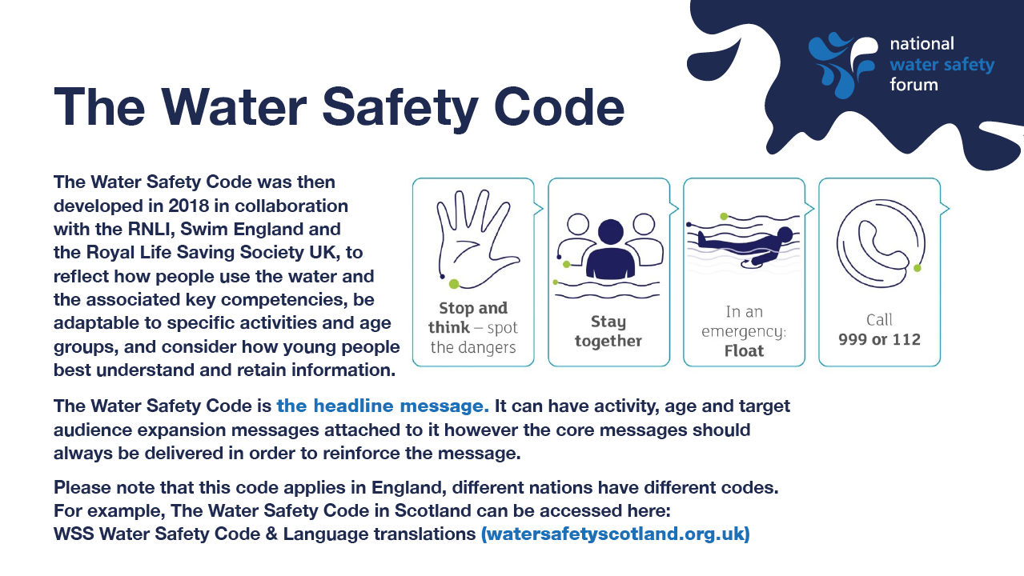
Notes:
The Water Safety Code was then developed in 2018 in collaboration with the RNLI, Swim England and the Royal Lifesaving Society UK, to reflect how people use the water and the associated key competencies, be adaptable to specific activities and age groups, and consider how young people best understand and retain information.
The Water Safety Code is the headline message. It can have activity, age and target audience expansion messages attached to it however the core messages should always be delivered in order to reinforce the message.
The impact of these messages have now been tested through the evaluation of the following programmes and campaigns;
Swim Safe – Immersive Intervention
RLSS Drowning Prevention Week - Campaign
RNLI Water Safety Workshops – Volunteer Delivery
Credit - Drowning Prevention Auckland, Water Competencies www.dpanz.org.nz
With reference to the above - References Slide
Drowning Prevention Auckland, (2023) Water Competencies Research [Online] Available: Water Competencies | Drowning Prevention Auckland (dpanz.org.nz)

Slide 9
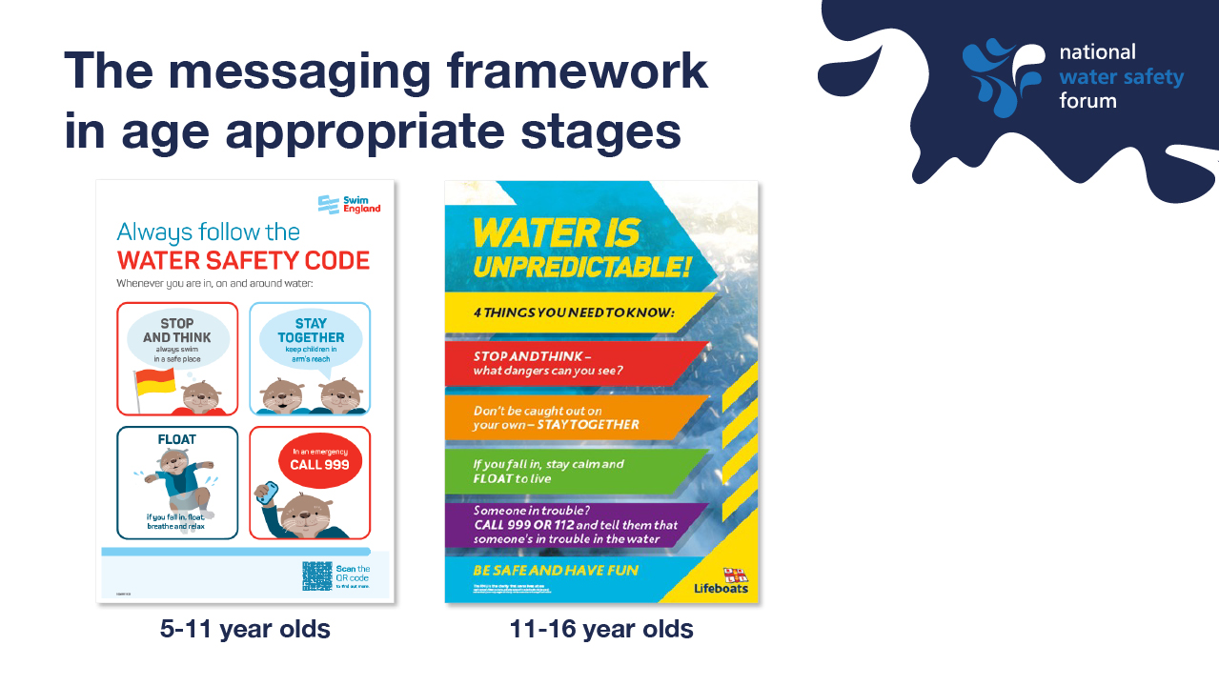
Notes:
The Framework comprises a document detailing headline messages, expansion messages and a range of learning outcomes that are age appropriate to support the development of materials such as the two posters you can see. The first has been developed for a 3-11 year old (+ parent) audience featuring simple, top line messaging with some further detail. The second has been developed for an 11-16 year old audience and provides additional detail and a more adult use of language (ie know the dangers).
We’ll now look at one example of the Stay Together headline message, delivered at 4 different age stages and associated outcomes.
Each outcomes is child centred, using language like “I know and I will” to outline by the end of a session or activity what the expected learning will be in language that is appropriate. Practitioners can differentiate and provide challenge by choosing to use outcomes at different stages along with suggested activities and delivery styles.

Slide 10
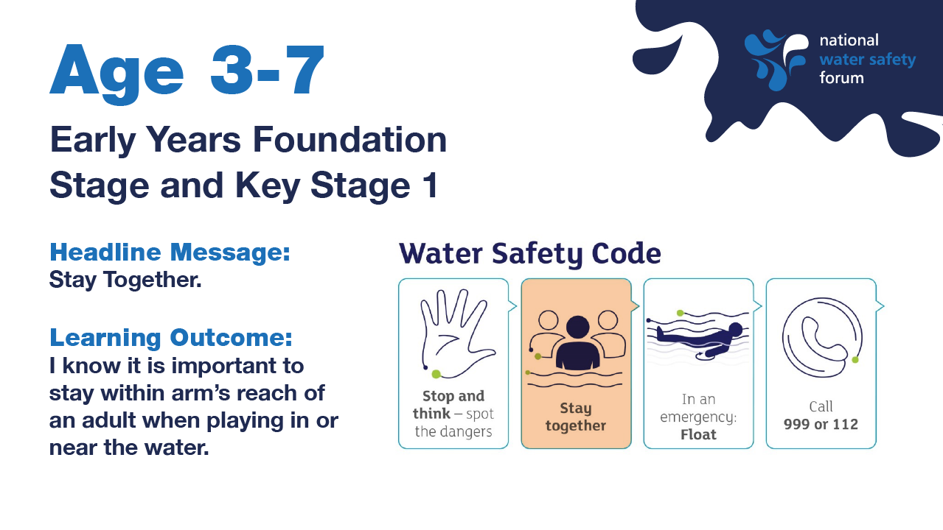
Notes:
Feedback from teachers - Teachers liked the repetition of skills in the early years, feeling this was essential for young children’s learning.
“The outline of skills looks good. I think it covers all the aspects the early level would need. Repetition in the early years is important as skills they learn in about one aspect are important to help them in different life experiences. If they are repeating skills they already know they are reinforcing their learning.” Primary teacher

Slide 11
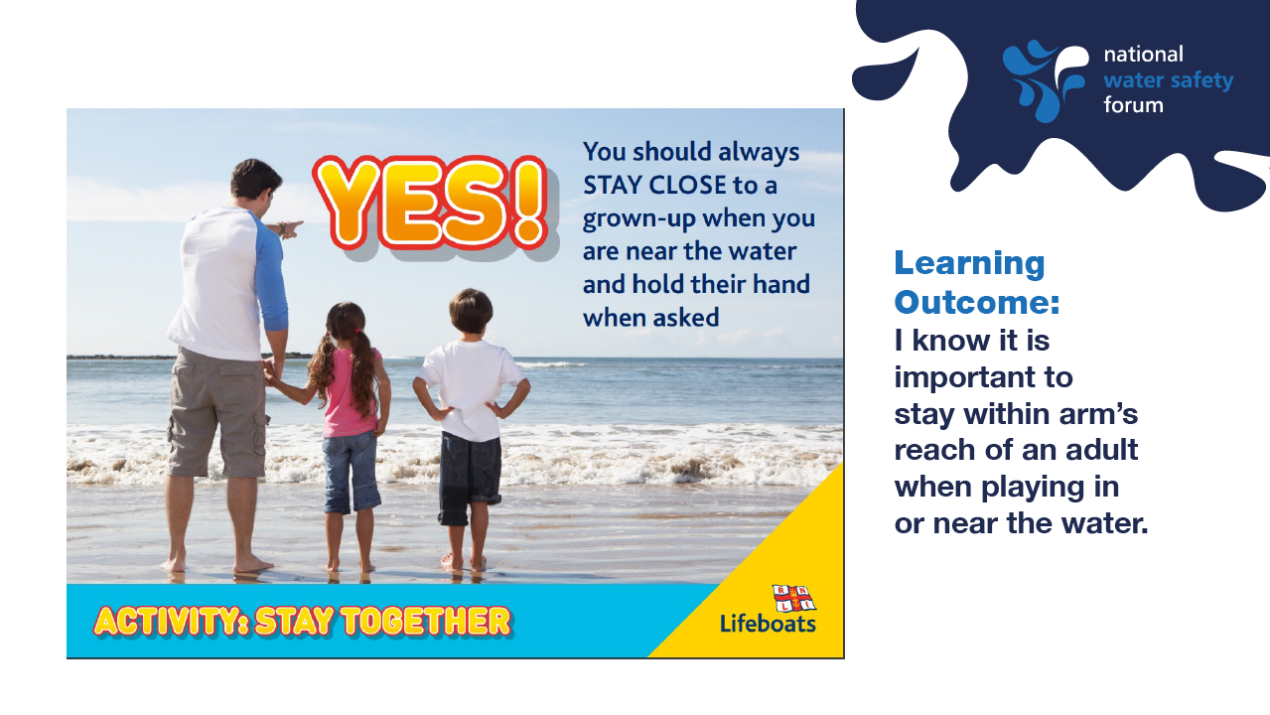
Notes:
What this outcome may look like in a resource can been seen above. Simple messaging with clear direction on the correct behaviour or key message, ie Stay Close to a grown-up when around water.

Slide 12
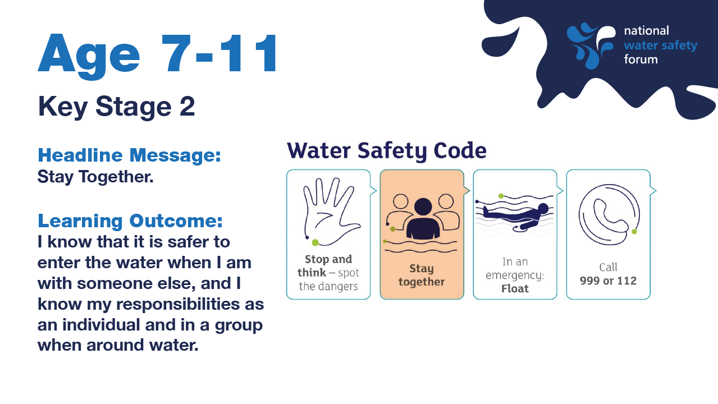

Slide 13
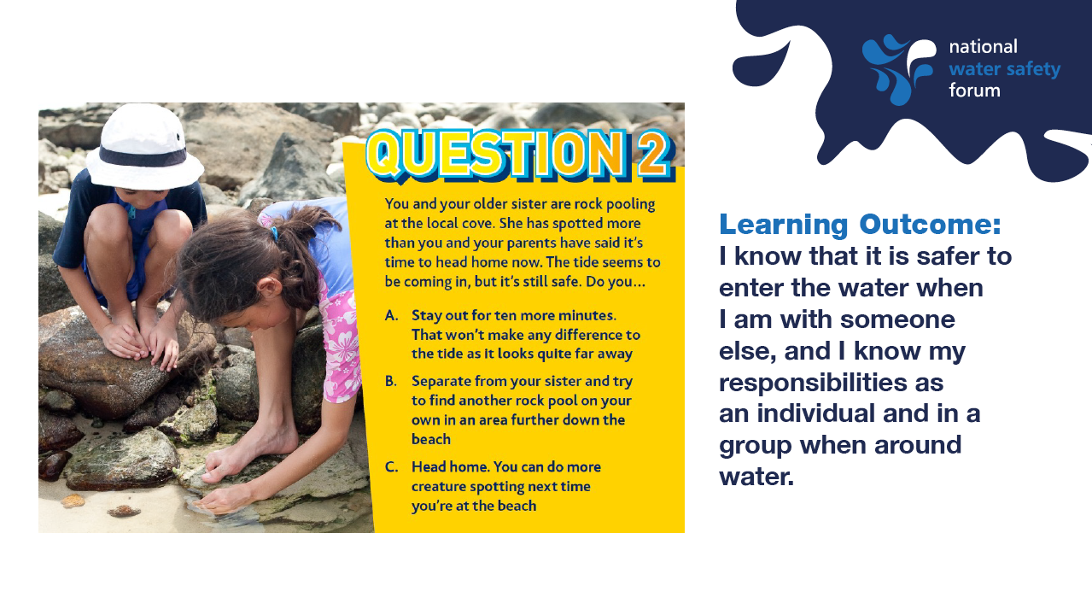
Notes:
This outcome builds on that for 3-7 year olds in that it reiterates the importance of supervision near to water, while acknowledging that the individual may be near water more frequently in a group setting or not holding an adults hand at all times. (ie a school trip to a beach location or weekend at a local park for a friends birthday party).
What this outcome may look like in a resource can been seen above. In this activity children are given 3 possible options to discuss and consider the safest course of action.

Slide 14
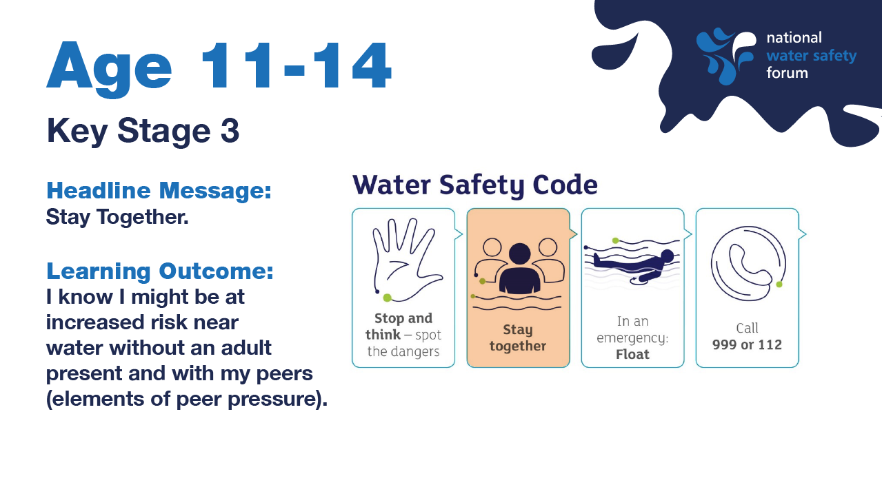

Slide 15
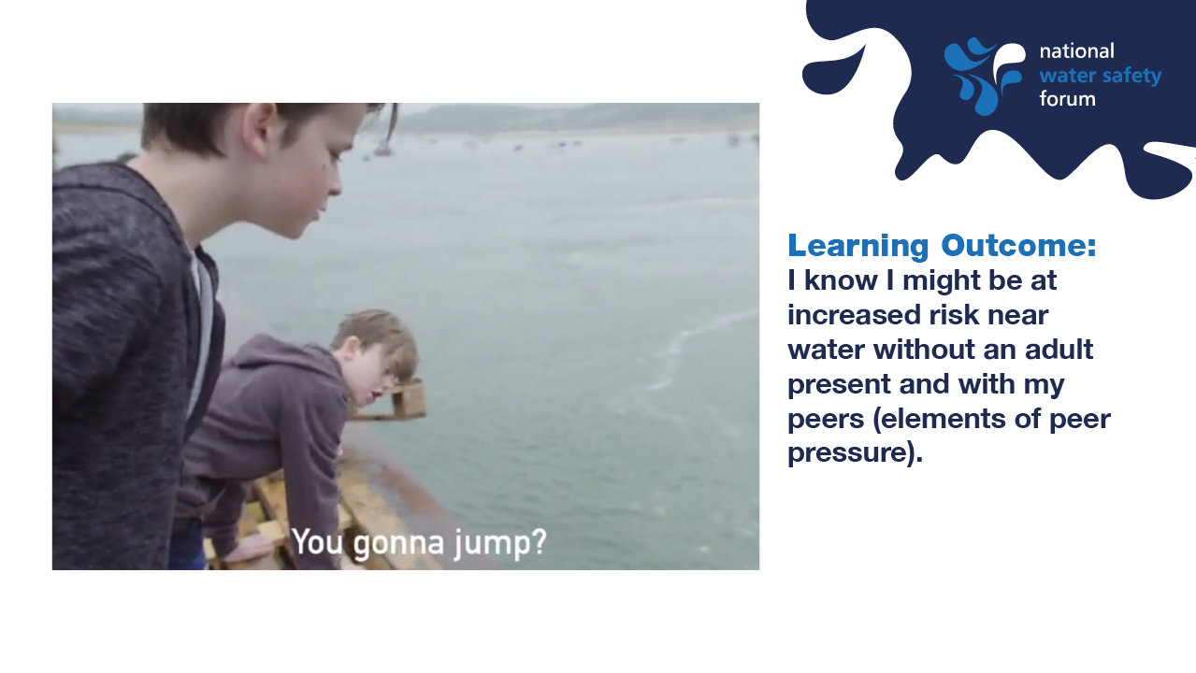
Notes:
This outcome acknowledges that many young people as they transition to secondary education will often be more independent when travelling to and from school and in their personal time. It also highlights that peer pressure is a potential risk when near to water.
What this outcome may look like in a resource can been seen above. Young people watch a decision making video in which an individual is encouraged to jump from a height in to water. At the point of the jump the video pauses and the group are encouraged to consider what risks have been overlooked. The end of the video includes an input from a Lifeguard about the dangers of jumping from a height into water and the end of the video models the individual dealing with peer pressure in a constructive way to support 11-14 year olds.

Slide 16
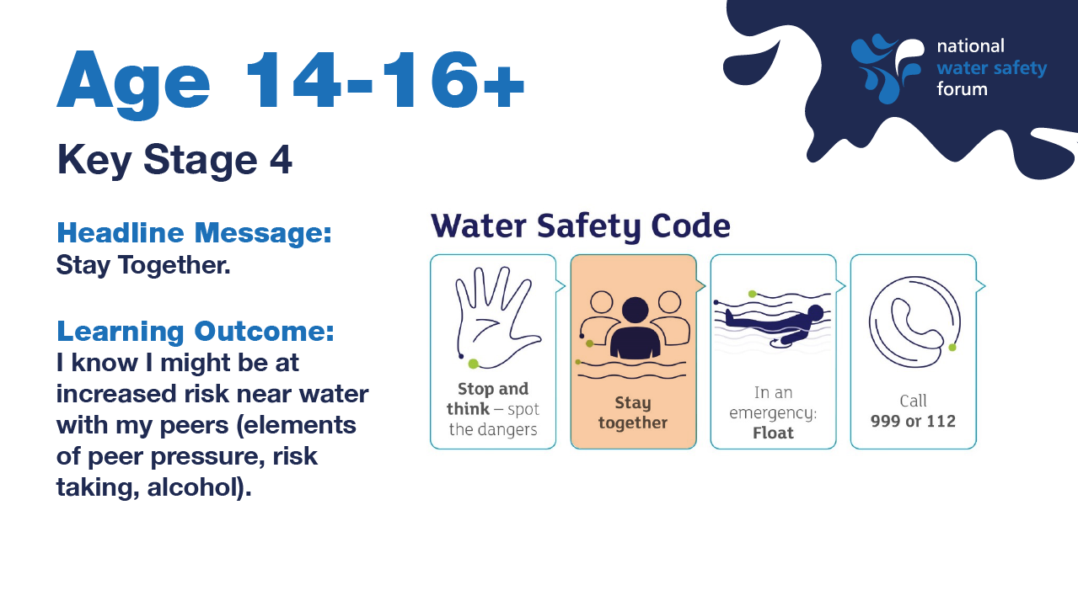
Notes:
Secondary teachers appreciated that the skills were made more ‘adult’ for the older age groups by introducing issues such as alcohol and water – though one teacher felt that in some areas this may need to be introduced earlier.
“I do think it is particularly important for the focus to change at the end of Key Stage 4 into Key Stage 5 to look at the dangers of alcohol and water and the effects this can have on the ability to make the correct decision. I often find that resources are a little patronising to older students but this seemed to realise that older students do not just want a rehash of what has been delivered lower down.” Secondary teacher

Slide 17
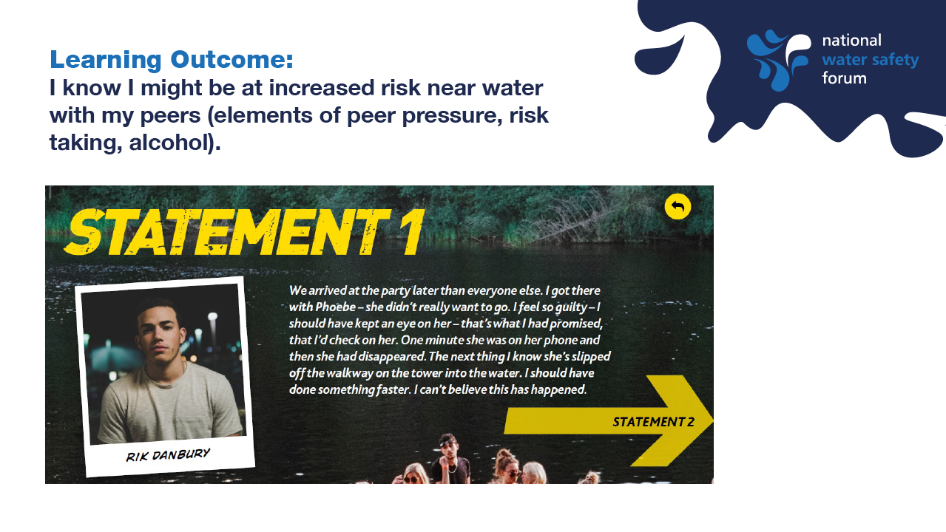
Notes:
This outcome acknowledges that many young people as they progress into becoming more independent while most likely spending an increasing amount of time with friends and peers away from their family home. It also notes that is may be appropriate to discuss and better understand the risks associated with consumption of alcohol and or drugs when near to water. ;
What this outcome may look like in a resource can been seen above. Young people watch are given a series of statements and other pieces of evidence to investigate and piece together an incident. They are then given the four key messages and asked to reflect on what could have been done to prevent the incident.

Slide 18
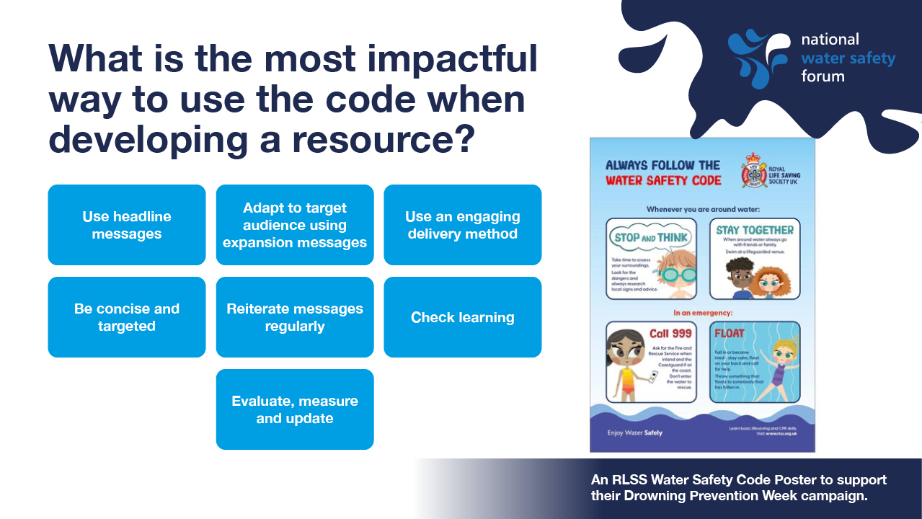
Notes:
How do I use the code to develop an intervention or resource?
Use headline messages
Adapt to target audience using expansion messages
Use an engaging delivery method
Be concise and targeted
Reiterate messages regularly
Check learning
Evaluate, measure and update

Slide 19
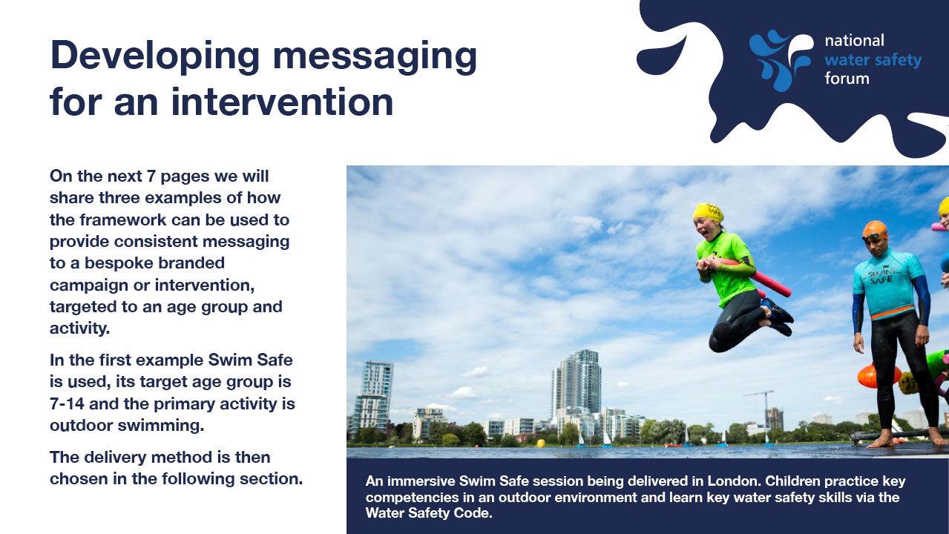

Slide 20
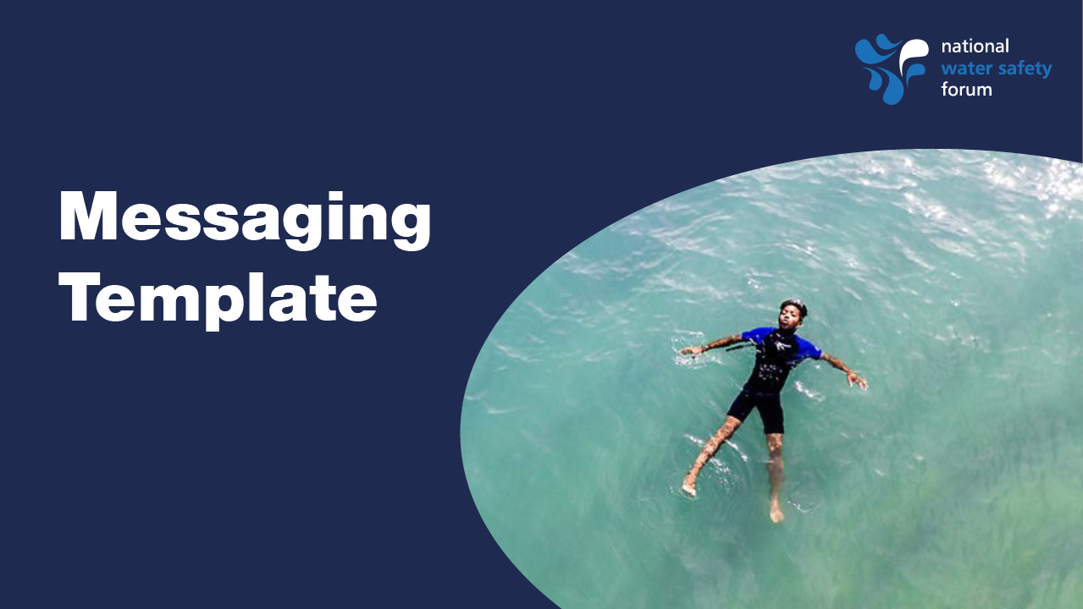

Slide 21
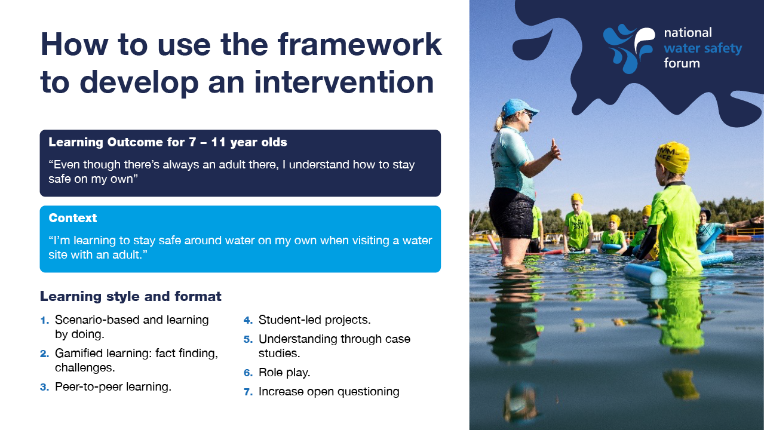
Notes:
Next step – highlight learning objective for age group, context and some suggested learning styles or formats.

Slide 22
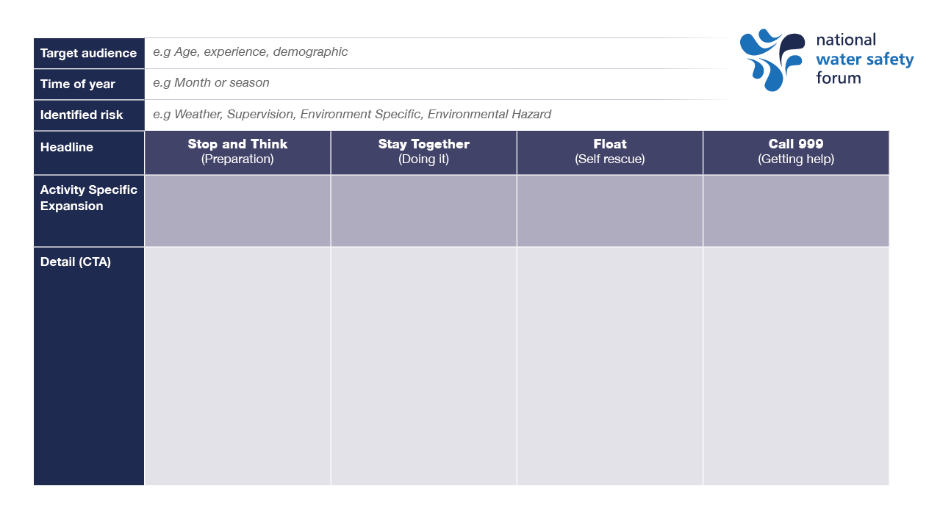
Notes:
Developing a message / share blank version /

Slide 23
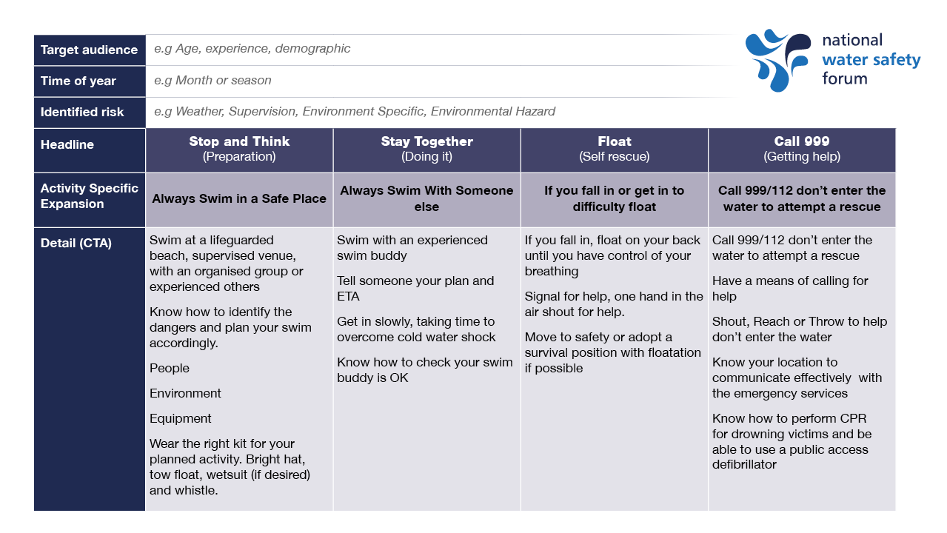
Notes:
Developing a set of messages and further detail highlighting activities that will be completed. Example; Swim Safe

Slide 24
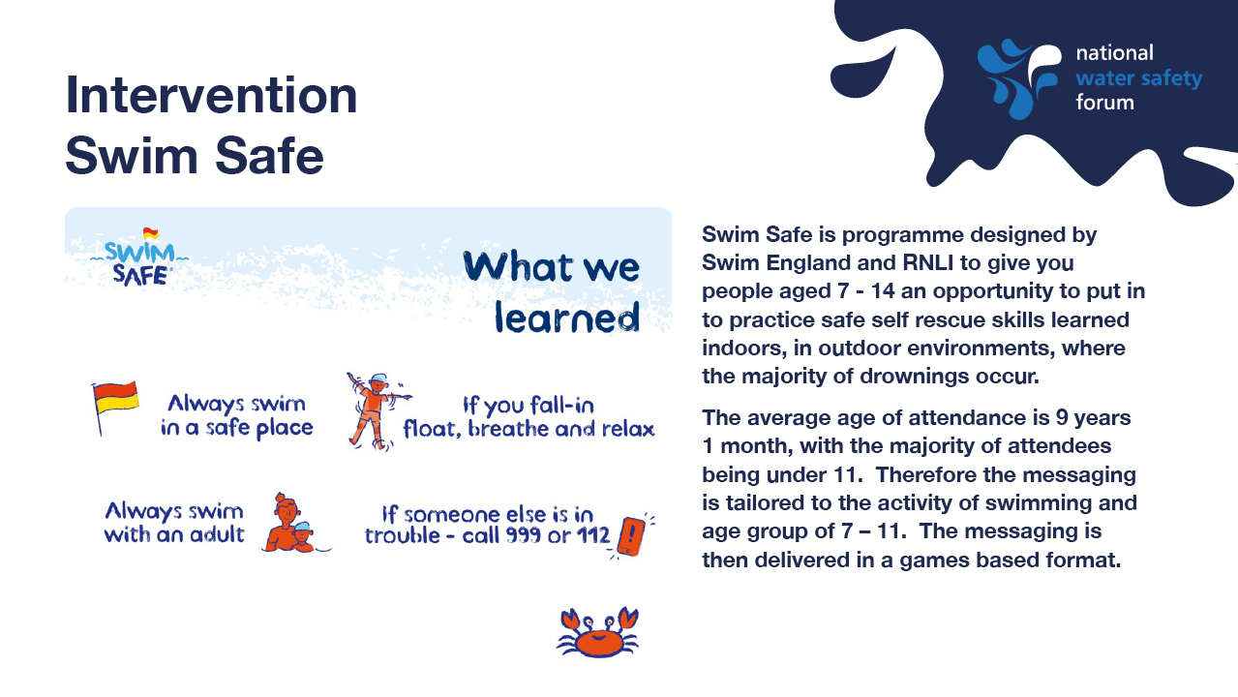
Notes:
https://swimsafe.org.uk/about
Suggest adding imagery to this page from page above. Please contact Ash for up to date suggestion.
Swim Safe is a fun and free water safety activity for children created by Swim England and the RNLI that takes place in the summer.
Why is Swim Safe needed?
Every year, RNLI lifeguards and lifeboats race to the rescue of children and adults who find themselves in difficulty in and near the water.
In 2013, Swim England (the national governing body for swimming in England) and the RNLI (the charity that saves lives at sea) launched Swim Safe to help children learn how to stay safe in and around open water before they might need to be rescued.
Swim England and the RNLI work closely with Swim Wales and a range of local delivery partners to make Swim Safe available to as many children as possible, whether they live by the coast, inland and in our cities.
Since launching with a single site in 2013, Swim Safe has grown to include more than 30 sites across England, Scotland, Wales, Northern Ireland, the Channel Islands and the Isle of Man.

Slide 25
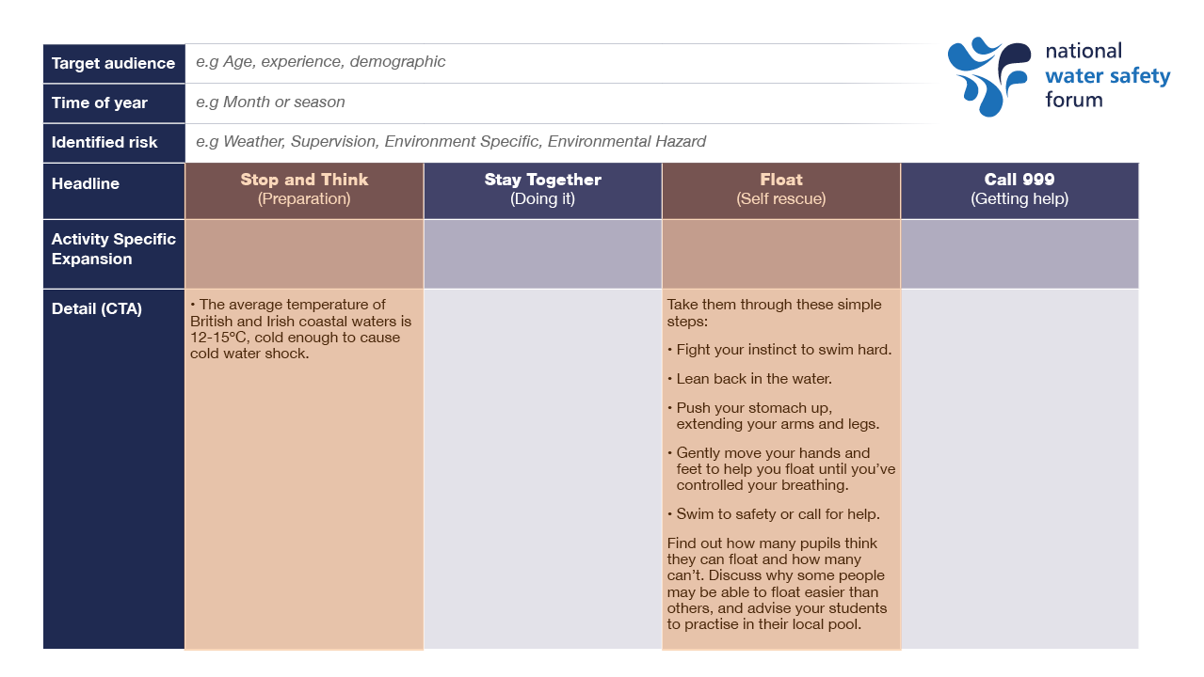
Notes:
Developing a message / share blank version /

Slide 26

ROSPA Water Safety Signs and Flags
RLSS Cross Curricular Thematic Lesson Plans
Swim England – Swimming and Water Safety
RNLI Water Safety Workshops
NWSF Respect the water
CRT Explorers
Yorkshire Water – Water Safety Live events
StayWise
Maritime and Coastguard Agency

Slide 27
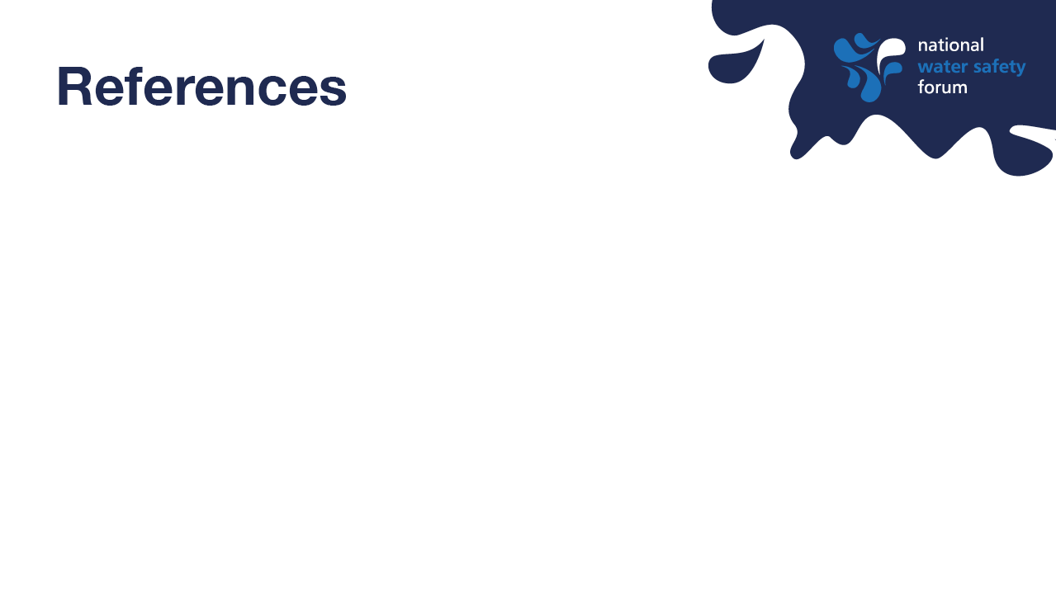
International Life Saving Federation (ILSF) (2007) Position statement on ‘Swimming and Water Safety Education’
National curriculum in England: physical education programmes of study’, Department for Education (2013) [Online] Available: https://www.gov.uk/government/publications/national-curriculum-in-england-physicaleducation-programmes-of-study/national-curriculum-in-england-physical-education-programmes-of-study
National Water Safety Forum (2016) The UK Drowning Prevention Strategy 2016-26, [Online] Available: https://www.nationalwatersafety.org.uk/strategy
NCMD (2023) [Online] Deaths of children and young people due to traumatic incidents Available: https://www.ncmd.info/publications/report-child-accident-injury/
RNLI (2023) ‘Water safety education in schools: measuring our impact’ [Online] Available: https://rnli.org/support-us/volunteer/volunteer-zone/volunteer-news/2023/june/water-safety-education-in-schools-measuring-our-impact
Stallman, Moran, Quan, & Langendorfer, (2017) ‘From Swimming Skill to Water Competence’ A Paradigm Shift," International Journal of Aquatic Research and Education: Vol. 10: No. 2, Article 2.
Tipton, M., Muller, J. H., Gȯmez, C., & Corbett, J. (2022) ‘Do water safety lessons improve water safety knowledge?’ International Journal of Aquatic Research and Education
World Health Organization; Geneva (2022) ‘Preventing drowning: practical guidance for the provision of day-care, basic swimming and water safety skills, and safe rescue and resuscitation training’

Slide 28
